Slide 1
ONE SHOT VIDEO SYNOPSIS
SHAMIT LAL (shamitl@)
SHIVAM DUGGAL (duggals@)
Team Name: Dancing Pandas

Slide 2
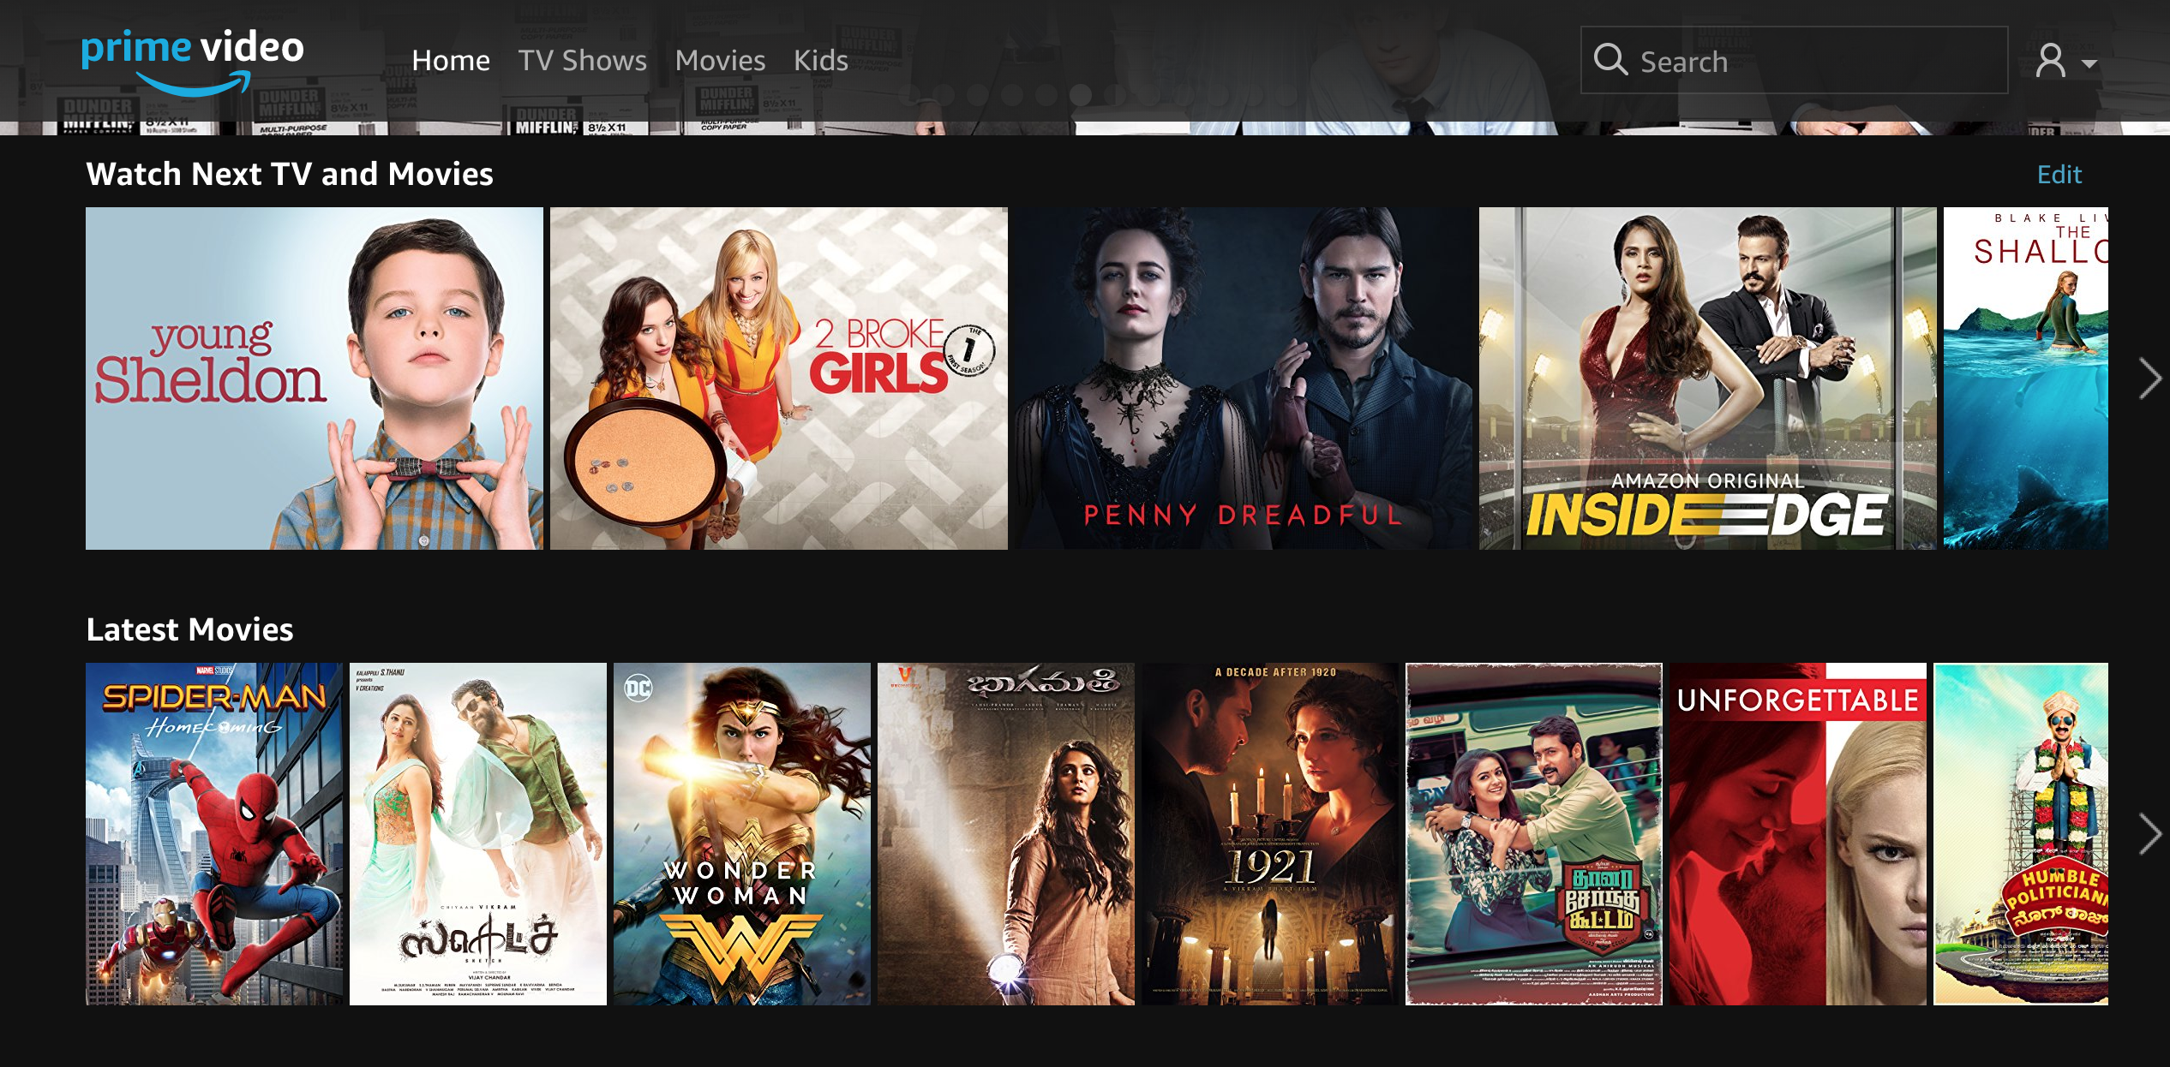

Choosing which video to watch based on thumbnails ?
It can be difficult to decide just based on the thumbnails as description.

Slide 3
ONE SHOT VIDEO SYNOPSIS
Oftentimes customers go through entire video only to realize later that it wasn't what they expected.
We propose a system that processes the entire video using sequential models and computer vision and provides a summarized video/gif that one can watch (clicking on the video title) to decide whether to proceed with the selected video or not.
This can save time for Amazon's customers.

Slide 4
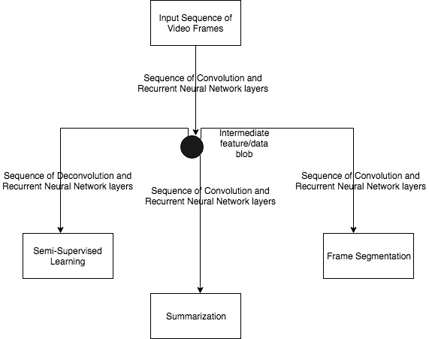
TECHNICAL OVERVIEW

Slide 5
ARCHITECTURE INSIGHTS
Using Convolutional and recurrent networks to establish relationships among multiple frames of a video.
Using a semi-supervised architecture to learn rich internal and sematic representations of a video which helps in the summarization process
Augmenting the training of summarization with shot boundary segmentation.

Slide 6
BUSINESS USECASE…
Highlights of sport events.
Catchy clips of a tourism video.
GIFS as thumbnails depicting important parts.

Slide 7
DEMO…
Original Video Link: https://www.youtube.com/watch?v=htP53EwTbjg
Summarized Video Link: https://drive.corp.amazon.com/documents/shamitl@/dancing_panda.gif
Original Video Length: 111 seconds
Summarized Video Length ~ 17 seconds
* NOTE: The GIF will re-loop after 17 seconds.

